Slide 1
Prof V Suresh Kumar Thiagarajar College of Engineering, Madurai
DC-AC Converters
(Inverters)
DEPT. OF ELECTRICAL ENGINEERING, COLLEGE OF ENGINEERING TRIVANDRUM

Slide 2
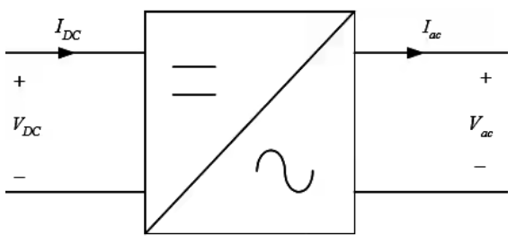
DC-AC Converter

Slide 3

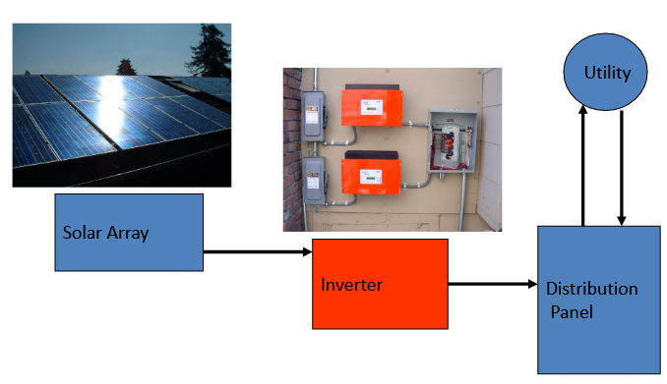
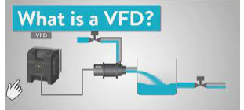

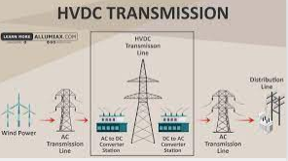
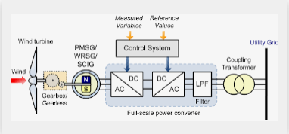
Applications…

Slide 4
Inverter Classification
Classification of inverters based on wave shape
Square wave
Quasi square wave
Sine wave
Classification of inverters based on Input
Voltage source
Current source
Classification of inverters based on power level
Single Phase Inverter
Half Bridge & Full Bridge
Three Phase Inverter

Slide 5
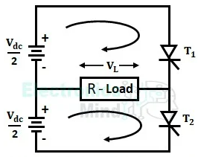
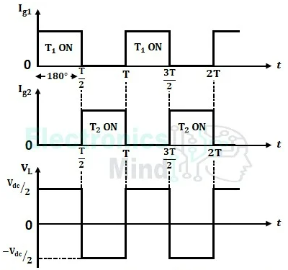
1- Phase Half bridge inverter with R - Load
Switches T1 and T2 used are gate commutated devices such as BJT, MOSFET, IGBT, GTO etc
T1 and T2 are turned on alternately to produce an ac voltage across the load
Each switch is ON for half time period (T/2) of the desired frequency

Slide 6















1- Phase Half bridge inverter with Inductive Load
Switches S1 and S2 used are gate commutated devices such as BJT, MOSFET, IGBT, GTO etc
E
DC
2
^{E}DC
2
S1 and S2 are turned on alternately to produce an ac voltage across the load
Each switch is ON for half time period (T/2) of the desired frequency

Slide 7
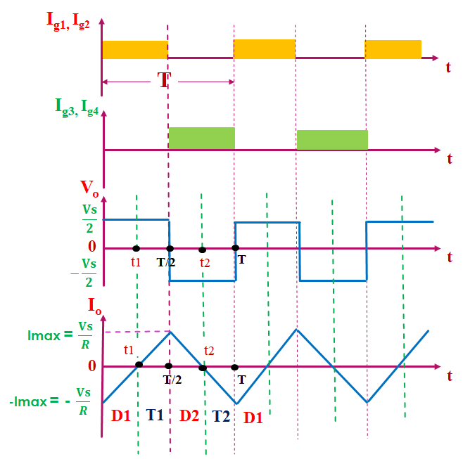

Slide 8
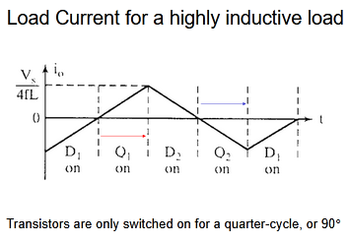

Slide 9
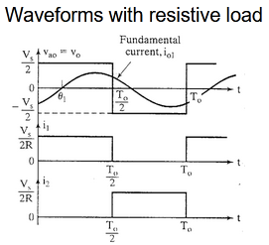
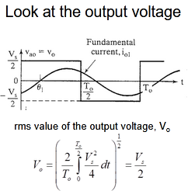

Slide 10
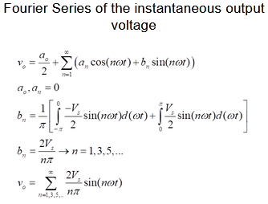
Due to quarter wave symmetry along time axis, a0 and an are zero

Slide 11
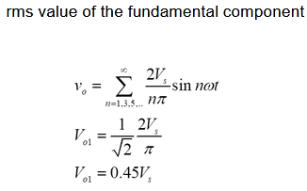

Slide 12











1- Phase Full bridge inverter
S1 and S2 turned on in the first half cycle (T/2)
S3 and S4 turned on in the second half cycle (T/2)

Slide 13




















Full bridge inverter – R load
Two modes of operation:
Mode 1:
S1 and S2 are ON Mode 2
S3 and S4 are ON

Slide 14












Full bridge inverter – RL load
Four modes of operation:
Mode 1: Mode 2: | S1 and S2 are ON, D3, D4 conducts, | Output +ve Output -ve
Mode 3: | S3 and S4 are ON, | Output –ve
Mode 4: | D1, D2 conducts, | Output +ve

Slide 15
Full Bridge Inverter – Transistor Ratings
^{V}CE (0) ^{≥ E}DC
I
₌ ^{E}DC
T (ave)
2R
I
₌ ^{E}DC
T ( peak )
R

Slide 16
Harmonics
Harmonics are frequencies that are positive integer multiples of a fundamental, base frequency (e.g., if the fundamental is 50 Hz, the 2nd harmonic is 100 Hz, the 3rd is 150 Hz).
OR
Harmonics are distortions of the pure AC sine wave caused by non-linear loads like computers and variable frequency drives, which can cause equipment damage or energy loss.

Slide 17
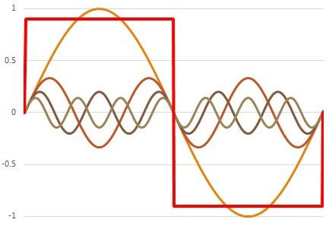
Harmonics
Original square wave
Fundamental component Third order harmonic
Fifth order harmonic
Seventh order harmonic
∞
4E_{DC}
nπ
sin (n ωt )
Fourier series for symmetrical square wave, e =
∑
n=1,3,5,..

Slide 18
Harmonics
∞
∑
n=1,3,5,..
4E_{DC}
nπ
( ωt )
Fourier Series, e =
sin n
V_{L}
2 _{E}
Fundamental output voltage, E = ²
1
π
DC
I
(rms)
L
ie. E₁ = 0.9 E_{DC}
_{n} th
order output voltage, E = ^{E1}
n
n
E=E_{DC}
RMS value, E =
_{E} 2
+ E ² + E ² + ...
3 5
(rms )
1
⎛
₂ ⎞
1
2
∞
= (E − E
Harmonic voltage, E = ⎜ ∑ E
2
2
)
1
⎟
² = 0.4352 E
h
⎝ n=3,5,..
n
⎠
1
DC

Slide 19


Harmonic Parameters
Harmonic factor for n^{th} harmonic measures the individual harmonic contribution
E
Harmonic Factor, HF =
n
n
E
1
Total harmonic distortion is a measures of how different is the actual waveform from its fundamental component
Harmonic factor is a measures of effectiveness in reducing unwanted harmonics using filters

Slide 20
Comparison of parameters in
Half Bridge and Full Bridge Inverters
Full Bridge
Half Bridge
Output voltage
E = E
E
₌ ^{E}DC
O
DC
O
2
Fundamental output voltage
2 _{E}
^{2 E}DC
E = ²
= 0.9 E
E = ²
= 0.45 E
1
π
DC
DC
1
π 2
DC
Harmonic output voltage
E = 0.4352 E
E = 0.2176 E
h
DC
h
DC
Peak breaking voltage of switches
E = E
E = E
BR
DC
BR
DC

Slide 21
Example
A single phase full bridge inverter is operated from 48 V battery and supplying power to a 24 ohm load. Determine output power, THD of output and transistor ratings.
Solution:
E² 48²
R 24
RMS Power, P =
= = 96 W
V_{CE} ≥ 48 V
E₁ = 0.9 E_{DC} = 0.9 × 48 = 43.2 V
E_{h} = 0.4352 E_{DC} = 0.4352 × 48 = 20.89 V
I
₌ ^{E}DC
R
= ⁴⁸ = 2A 24
T ( peak )
THD = ^{Eh} = ^{20.89} = 48.36 %
E₁ 43.2

Slide 22















Cross Conduction or Shoot Through Fault
Normally the switches in the bridge switch on in pairs – S1-S2 turn on first and after they are off, S3-S4 turn on
Therefore the switches in the same leg (say S1 and S4) may not turn on at the same time
Due to turn off delay, incoming device and outgoing device of the same leg in the bridge conduct at the same instant and short circuits the DC source.
This fault damages both the devices

Slide 23






Cross Conduction or Shoot Through Fault
A solution for cross conduction fault is to introduce a dead band or delay between the trailing edge of the gate input of outgoing device and the leading edge of the gate input incoming device
Dead band should be longer than the turn off time of the inverter

Slide 24
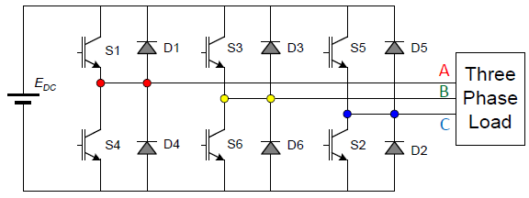






3-Phase Inverter
Load configurations
A
R
R
B
_{C} R

Slide 25




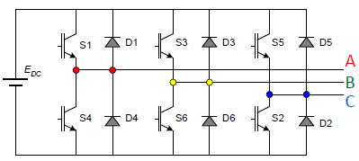









3- Phase Inverter
180° conduction
^{2 E}dc
3
1
Connection during first interval
1 _{E}
DC
^{E}dc
3
3
N

Slide 26
3- Phase Inverter
180° conduction
^{2 E}dc
3
1 _{E}
3
2
dc
Connection during second interval
E
₃ DC
N

Slide 27
3- Phase Inverter
180° conduction
^{2 E}dc
3
Interval | Incoming Device | Conducting Devices
1 | S1 | 5,6,1
2 | S2 | 6,1,2
3 | S3 | 1,2,3
4 | S4 | 2,3,4
5 | S5 | 3,4,5
6 | S6 | 4,5,6
^{1 E}dc
3

Slide 28












Features of 180 degree conduction
Conduction period for each switch is 180°
Three switches conduct at a time
There is possibility of cross conduction if a dead band delay is not deliberately introduced.
Phase voltages are six step waves
Line voltages are quasi square waves

Slide 29





3- Phase Inverter
120° conduction
^{E}dc
2
Connection during first interval
N
^{E}dc
^{E}dc
2

Slide 30
3- Phase Inverter
120° conduction
^{E}dc
2
Connection during second interval
N
^{E}dc
^{E}dc
2

Slide 31
3- Phase Inverter
120° conduction
^{E}dc
2
Connection during third interval
N
^{E}dc
^{E}dc
2

Slide 32
3- Phase Inverter
120° conduction
^{E}dc
2
Interval | Incoming Device | Conducting Devices
1 | S1 | 6,1
2 | S1 | 1,2
3 | S3 | 2,3
4 | S4 | 3,4
5 | S5 | 4,5
6 | S6 | 5,6
^{E}dc
^{E}dc
2

Slide 33












Features of 120 degree conduction
Conduction period for each switch is only 120°
Only two switches conduct at a time
Two switches in the same leg of bridge have inherent dead band of 60° and there is no possibility of cross conduction
Phase voltages are quasi square waves
Line voltages are six step waves
^{E}dc

Slide 34
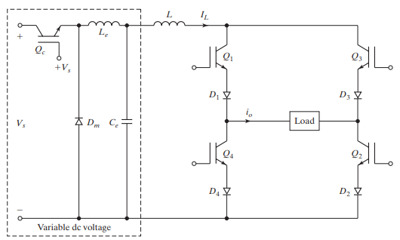
Current Source Inverter (CSI)
The output current is maintained constant irrespective of load on the inverter and the output voltage is forced to change.
In a VSI, the load current depends on the load impedance, whereas the load voltage in a CSI depends on the load impedance.

Slide 35
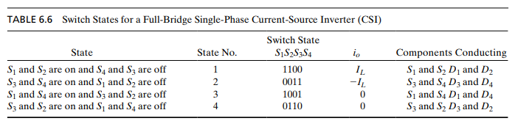

Slide 36
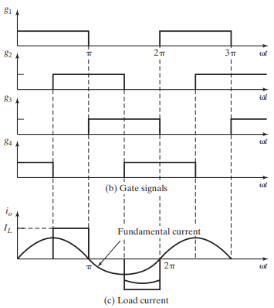

Slide 37
Current Source Inverter
The CSI is a dual of a VSI. The line-to-line voltage of a VSI is similar in shape to the line current of a CSI.
The advantages of the CSI are
(1) since the input dc current is controlled and limited,
misfiring of switching devices, or a short circuit, would
not be serious problems;
(2) the peak current of power devices is limited;
(3) the commutation circuits for thyristors are simpler;
(4) it has the ability to handle reactive or regenerative
load without freewheeling diodes.

Slide 38
A CSI requires a relatively large reactor to exhibit current-source characteristics and an extra converter stage to control the current.
The dynamic response is slower.
Due to current transfer from one pair of switches to another, an output filter is required to suppress the output voltage spikes.

Slide 39




Voltage Control with Pulse Width Modulation
Single Pulse width Modulation
Consists of a pulse with variable width in each half cycle
width varies from 0 to π
Multiple Pulse Width Modulation
Is an extension of single PWM and uses several equidistant pulses in each half cycle
Sinusoidal Pulse Width Modulation
Pulse width is a sinusoidal function of angular position of the pulse in a cycle

Slide 40


Single PWM
Carrier Wave
Comparator
Square Wave

Slide 41


Single PWM
^{π} + d
2
3π
2
π
2
π
Peak value of nth harmonic,V
= ^{4 VDC} sin nd
onm
nπ
When pulsewidth is 120°, d = 60°
Then peak value of 3rd harmonic, V
= ^{4 VDC} sin 3× 60 = 0
o3m
3π
This implies, when the pulse width is 120°, third harmonics will be eliminated

Slide 42
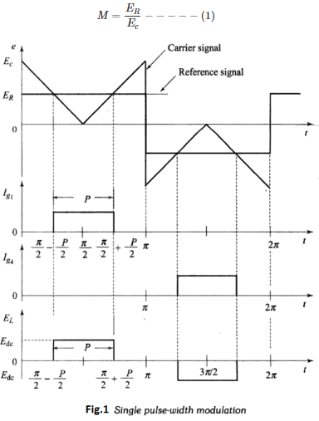

Slide 43
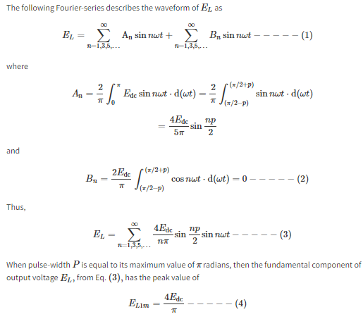

Slide 44
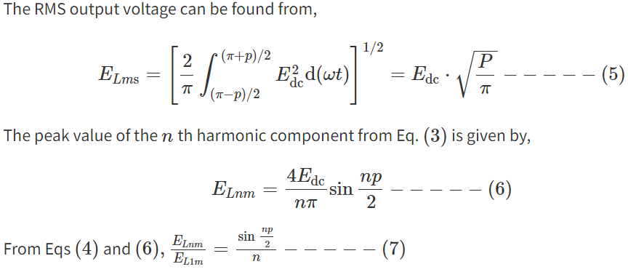

Slide 45
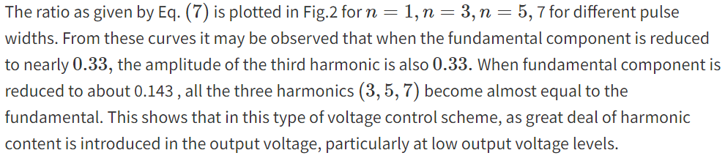
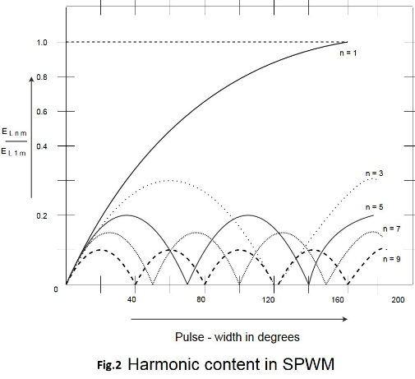

Slide 46
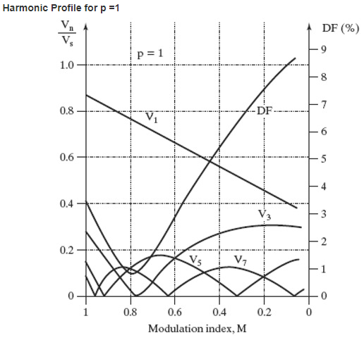
Harmonic profile of single pulse width modulation

Slide 47


Multiple Pulse Width Modulation
Carrier Wave
Comparator
Square Wave
N_{p} = number of
pulses in a half cycle
P = pulse width
1
⎡ N_{p} × P ⎤ ²
RMS value of output voltage, V = V
DC ⎢
⎥
⎣
π
⎦

Slide 48
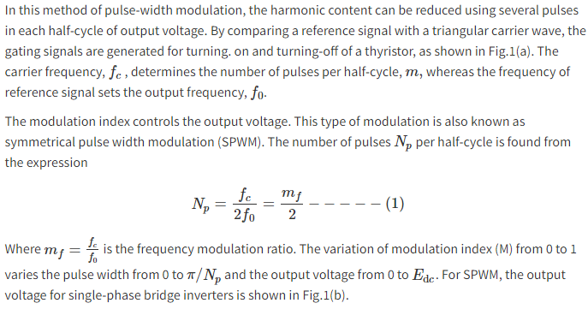
Multiple PWM

Slide 49
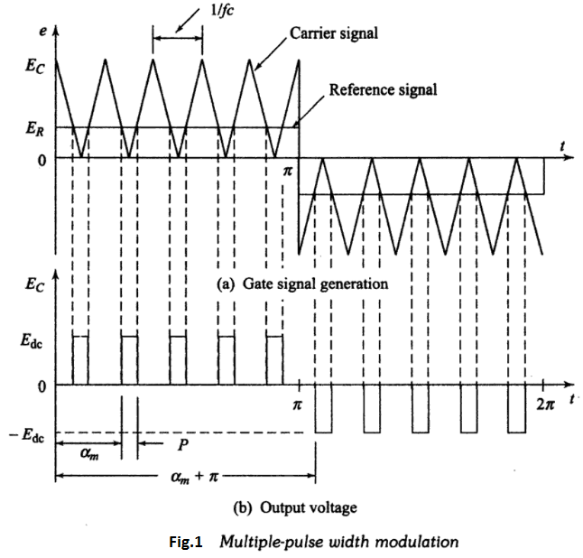

Slide 50
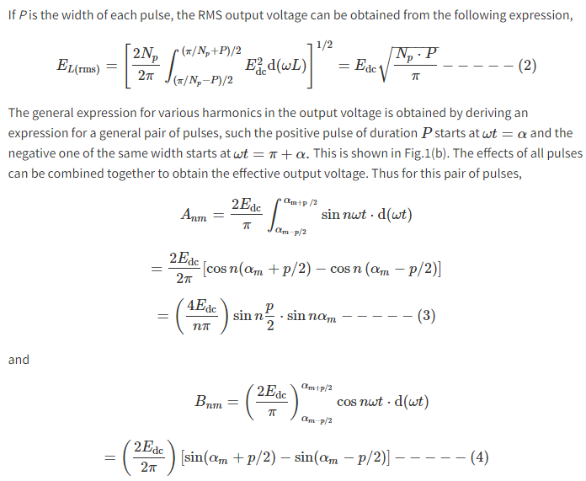

Slide 51
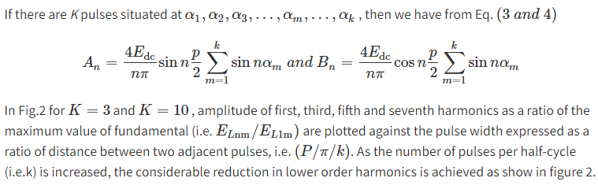
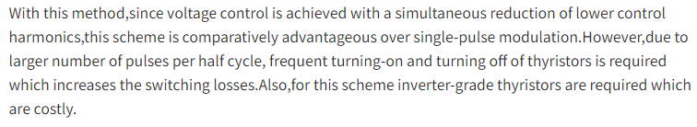

Slide 52
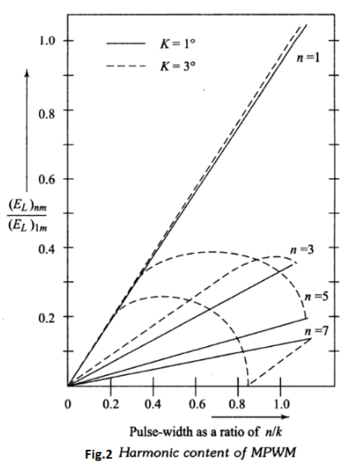
Harmonic profile of multiple pulse width modulation

Slide 53
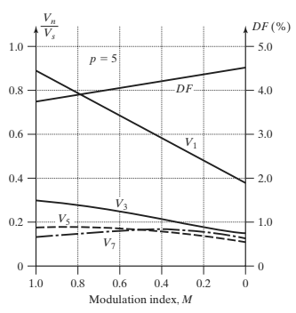
Harmonic profile of multiple pulse width modulation

Slide 54
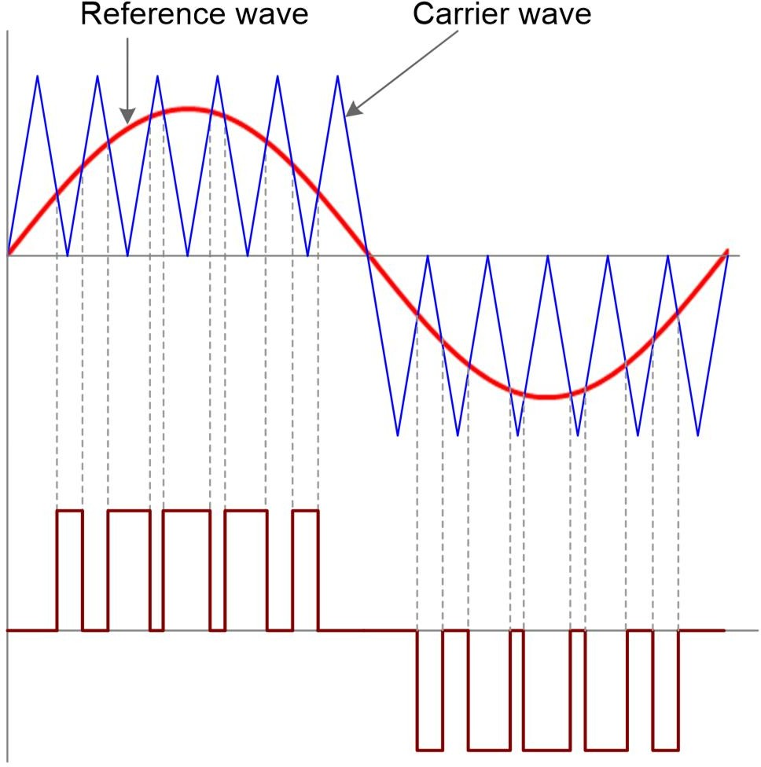

Sine Pulse Width Modulation
Modulation Index, MI = ^{Vr}
V_{c}
where V_{r} is the peak of reference wave and V_{c} is the peak of carrier wave
There will be low order harmonics when MI is greater than 1

Slide 55
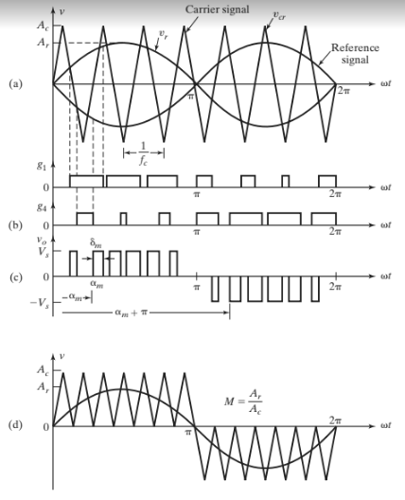

Slide 56
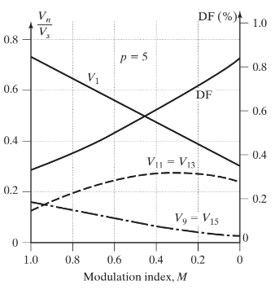
Harmonic profile of Sine pulse width modulation

Slide 57
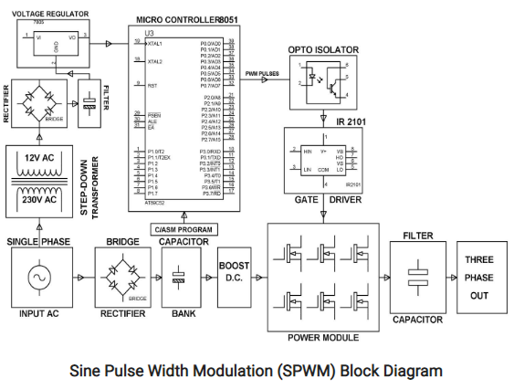
https://www.watelectronics.com/sine-pulse-width-modulation-spwm-working/

Slide 58
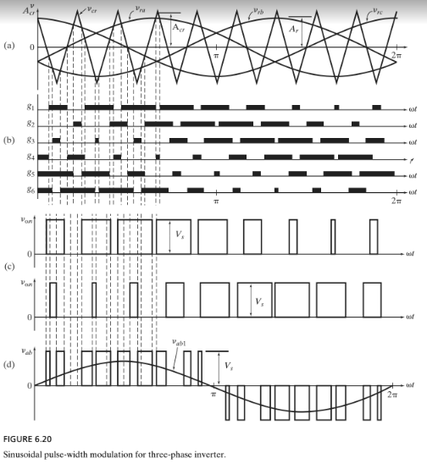
Sine PWM for 3-Phase Inverter

Slide 59
Space Vector PWM
SVM is a digital modulating technique where the objective is to generate PWM load line voltages that are in average equal to a given (or reference) load line voltage. This is done in each sampling period by properly selecting the switch states of the inverter and the calculation of the appropriate time period for each state. The selection of the states and their time periods are accomplished by the space vector (SV) transformation

Slide 60
Conclusion
The PWM technique can be applied to vary output
voltage and frequency of inverters
Sine PWM, or SVPWM scheme improves the quality
of its waveform

Slide 61
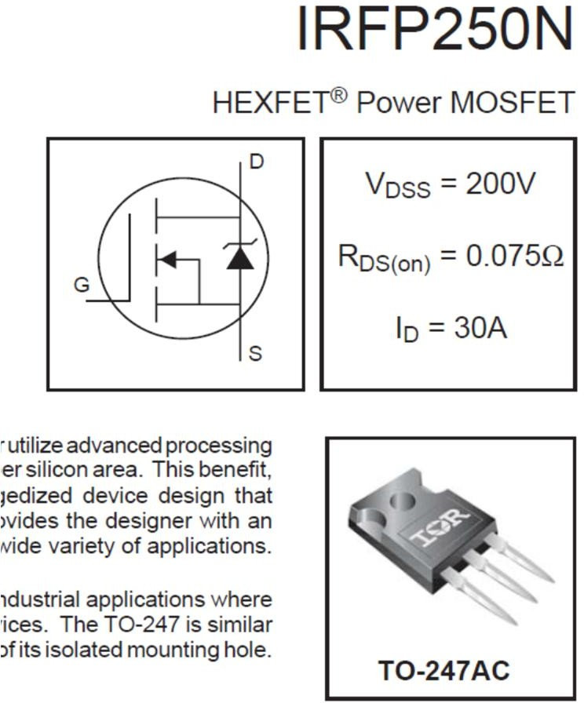
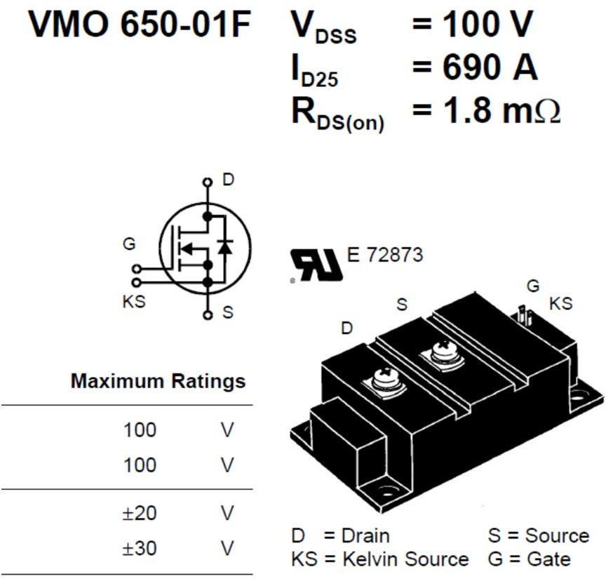
Typical MOSFETS

Slide 62
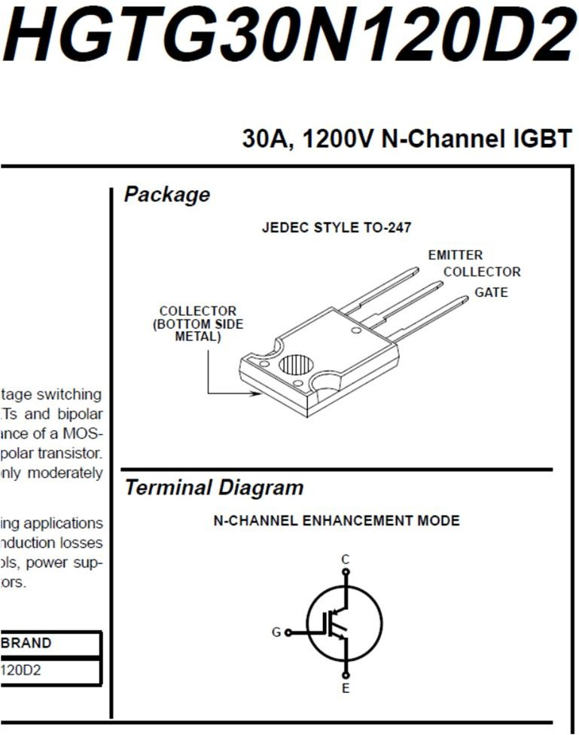
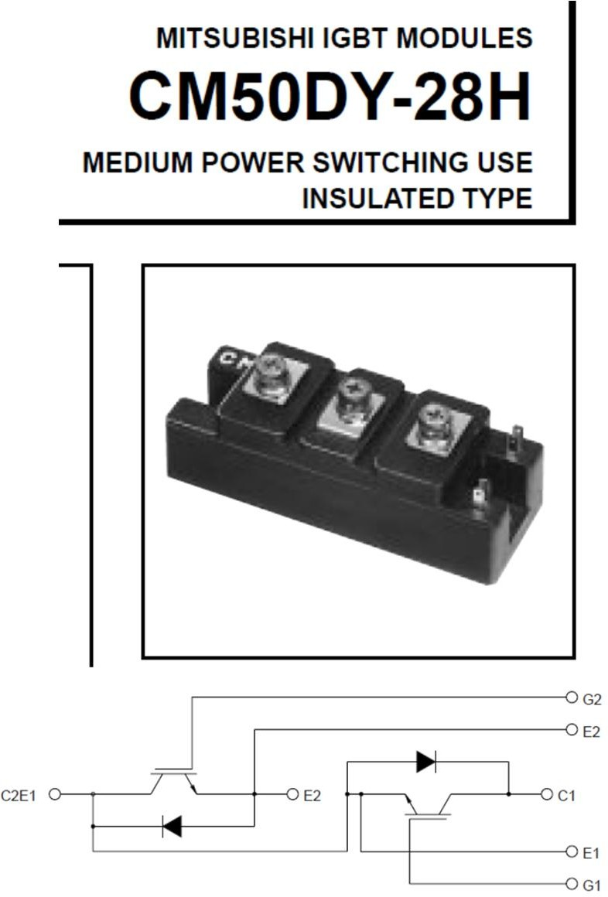
Typical IGBTs

Slide 63
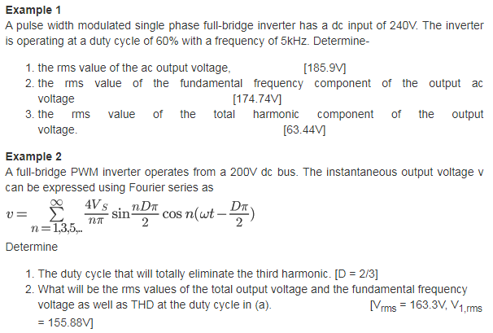

Slide 64
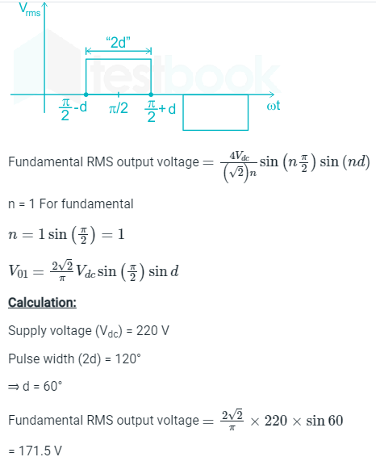
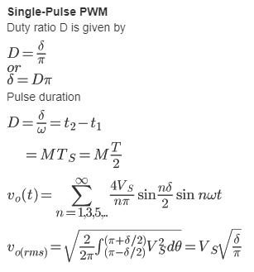

Slide 65
